Slide 1
RISK MANAGEMENT PLANNING with Complex Cases
15th April 2015 (Melbourne)
Indigo Program – CoHealth
Dr. Dion Gee
Australasian Psychology Services
Dr.Gee@AustralasianPsychologyServices.co : www.AustralasianPsychologyServices.co
Notes:
Templates:
Risk management plan (RMP) – in particular templates that are holistic (all areas of life) and can integrate multiple perspectives eg service/discipline
Behaviour management/Support plan (BM/SP)
Risk assessment/tools- which ones???
Understanding the difference between RMP and BM/SP. Including practical guidance eg when to use, for what purpose, recommended content, holistic V’s specific
Discuss different examples of RMP and BM/SP including extensive holistic documents V’s brief plans and how these are utilised for different purposes
How to assist care team to develop RMP and BM/SP
Developing a RMP that encompasses the MACNI platforms within the Assessment/Service Plans eg What are the risk factors for someone losing their housing, who would be responsible for managing this, timeframes and what would be the likely outcome
Framework for risk assessment in those circumstances where no formal assessment exists, that prompts the discussion of from what discipline, and from what evidence base
Developing a common conversation/understanding around ‘professional defensible risk’.
Developing confidence/expertise in integrating risk assessments and directing discussion accordingly
Particularly positive risk- that is encouraging a common commitment to acceptable parameters for risk. ( I think this relates to our discussion this morning to new emerging DHHS lingo re Low/Med/High risk v Acceptable/Tolerable risk)
Risk Management within a certain framework eg Disability- within the broader conversation of ‘risk’ how do we shift the conversation from ‘behaviour management’ to positive behaviour support.

Slide 2
I would like to take this opportunity to acknowledge the traditional owners and custodians of the land on which we meet today, the Wurundjeri people of the Kulin Nation; and pay my respects to their Elders, both past and present.

Slide 3
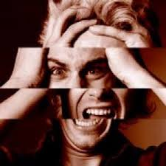
Overview
Systemic Frameworks
The Language of Risk
The Method of Risk
Risk Assessment
Risk Instruments
Contextualising Harm
Recording Risk
Risk Management Planning
Communicating Risk

Slide 4
Systemic Frameworks The conceptual boundaries of risk!

Slide 5
Governing Legislation
Disability Act 2006
Mental Health Act 2014
Children, Youth & Families Act 2005
Crimes (Mental Impairment and Unfitness to be Tried) Act 1997
Crimes Act 1958
Evidence Act 2008
Occupational Health & Safety Act 2004
Victorian Charter of Human Rights & Responsibilities Act 2006
Freedom of Information Act 1982
Residential Tenancies Act 1997

Slide 6
The Language of Risk The terms by which risk is conceptualised!

Slide 7
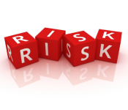
Risk
Risk is the potential for an adverse event to lead to a negative outcome, and by assessing risk we seek to estimate how likely the event is to occur and the nature and seriousness of its impact. In this context, the ‘adverse event’ is aberrant behaviour and the negative outcome is the degree and nature of ‘harm that it causes’.

Slide 8
Harm
Harm is defined as loss, damage or personal injury. Personal injury may be of a physical or psychological nature. The aim of risk assessment is to reduce the incidence of aberrant behaviour and the harm it causes, and particularly to identify the potential for personal injury in order to prevent it. Harm may be caused by a range of behaviours.

Slide 9
Violence
The World Health Organization defines violence as:
The key elements contributing to violence are the ‘level of intent’, the ‘use of coercion or force’, and the potential for harm to the person’, whether this is realised or not.
“the intentional use of physical force or power, threatened or actual, against oneself, another person, or against a group or community, that either results in or has a high likelihood of resulting in injury, death, psychological harm, mal-development or deprivation”, and identifies four means “by which violence may be inflicted: physical; sexual; and psychological attack; and deprivation”.

Slide 10
The Method Of Risk The manner by which risk is framed!

Slide 11
The Risk Process

Slide 12
Risk Assessment The means by which risk is understood!

Slide 13
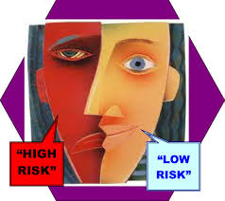
The Process of Risk Assessment
Includes the identification; analysis and evaluation of the best available information, which is then communicated to inform decision making and action. The ultimate aim is reducing the likelihood and impact of future aberrant behaviour.
Gather and review the relevant information to identify the: Historical and current factors about the person, his or her life circumstances and behaviour that support further offending (risk factors) or desistance (strengths). Can be assisted by the application of appropriate risk tools!
Analyse this information: To further identify how likely further offending is in the long term and in the current context given the presence and balance of risk, strength and any identified protective factors.
Evaluate this analysis: Evaluate against the appropriate criteria, and the context and purpose of the assessment, and make a decision on the most appropriate course of action.

Slide 14
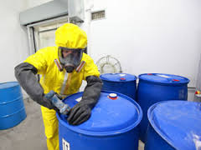
Consideration of Risk Factors
Risk factors are individual characteristics that increase or decrease the probability of recidivism.
Risk of harm always take into account both ‘static’ (relatively unchangeable) & ‘dynamic’ (changeable over time and circumstances) factors.
Understanding the distinction between types of risk factors helps to appreciate their role in assessment and in their relative contribution to how, why and when offending occurs.

Slide 15
Static Risk Factors
Historical factors that have been demonstrated to relate to recidivism potential.
Are non-changeable aspects of the individual.
Long term markers, and do not give a good understanding of current risk or intervention needs/treatment targets.

Slide 16
Dynamic Risk Factors
Factors associated with offending/recidivism that are amenable to change.
Can fluctuate over time.
Assessment gives a better understanding of shorter term risk.
Can be strengthened with supervision, and provide treatment targets for intervention.

Slide 17
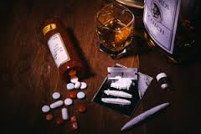
Types of Dynamic Factors
Stable: Enduring changeable characteristics linked to the aberrant behavior.
Acute: Rapidly changing changeable characteristics; may indicate that an aberrant behaviour will occur within a short period of time.
Some factors may be both stable and acute.
Require more regular re-assessment/monitoring (children/juveniles at least 6-monthly).

Slide 18
Risk Factor Exercise
Static or Dynamic
Age
Substance Use
Intimacy problems
Anger
Negative mood
Victim Access
Offence Cognitions
Self-regulation
Family History
Dissocial Peer
Expressed ideation
Mental Illness
Prior History
Child Abuse
Employment

Slide 19
Suicide/Self-Harm Risk Factors
Static factors include:
Dynamic factors include:
being male
being young or very old
previous attempts or self harm
history of mental illness
history of childhood abuse
alcohol dependency
medical illness
family history of suicide
family history of mental illness
low socio-economic status
unemployment
living in a rural area
suicidal thoughts
availability of means to suicide (e.g., firearms, medication, substances)
feelings of hopelessness
harmful use of substances
stressful life events
legal problems
financial problems
poor social supports
impulsivity
interpersonal problems
perceived ability to cope

Slide 20
Violence Risk Factors
Static factors include:
Dynamic factors include:
a previous history of violence
psychopathy
substance abuse
male gender
young age
criminal history
childhood abuse or maladjustment
violent ideation
psychiatric ideation
psychiatric diagnoses
psychiatric symptoms
suicidal thoughts
treatment non-compliance
stress
poor family relations
anger
tendency to be impulsive
thoughts about suicide
positive psychotic symptoms
substance abuse
lack of community support or supervision

Slide 21
Strengths
Positive characteristics within the person that can make an individual more resilient to adverse events.
Positive Coping, Empathy, Self-control, Secure attachment style.
Predispose client towards prosocial, or encourage, non-criminal behaviour.
Help to promote desistance from further aberrant behaviour.
Disincline an individual from violence or aberrant behaviour due to their personal values.
Not considered protective, as they do not mitigate against the risk of harm.

Slide 22
Protective Factors
Circumstances, relationships or characteristics that have a mitigating effect on the likelihood of future harm.
Medication, Leisure activities, Life goals, Professionals, Living situation.
Differentiated in terms of immediacy
Remand in domestic violence, remove child vs. IVO or responsible adult.
When present, act to prevent or interrupt an episode of potentially harmful behaviour.
When absent they do not act to pose extra risk.
Important in risk management, providing balance to the risk assessment, offering positive intervention goals and inspiring motivation in staff and client.

Slide 23
Risk Instruments The tools of the trade!

Slide 24
Assessment Approaches
1st Generation = “Clinical Judgment”
Unstructured, non-replicable, personal discretion.
Based on experience & knowledge of the literature.
Non-standard (even within same institution).
Level of prediction little better than chance.
2nd Generation = “Actuarial Assessment”
Static, structured, replicable, less open to interpretation.
Based on historical factors empirically related to recidivism.
Standardized assessment, ‘static’ - cannot measure change.
‘Moderate’ levels of prediction.
Unable to show change.

Slide 25
Structured Professional Judgement
3rd Generation = “Dynamic Assessment”
‘Not Perfect’ – includes dynamic and changeable items.
Based on factors empirically related to recidivism.
Standardized assessment of risk level and client needs.
Measures change & capable of re-assessment.
Still working on predictive validity.
4th Generation = “Structured Professional Judgment”
Include identification of client’s strengths.
Assess client’s responsivity factors.
Include particular non-criminogenic needs.
Stresses the integration of assessment into intervention, case planning, management, evaluation and review.

Slide 26
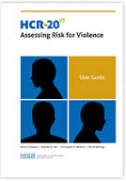
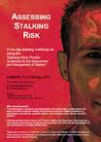
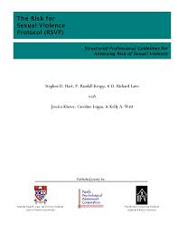
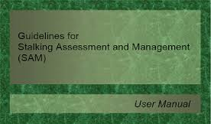
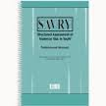
Assessment Tools
SPJ
Actuarial
Risk Matrix-2000
RRASOR
Notes:
General Violence: Violence Risk Assessment Guide
Sexual Violence: Static-99R; Risk Matrix 2000; The Rapid Risk Assessment for Sex Offence Recidivism,

Slide 27
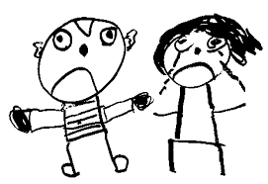
Risk Of What?
Risk to Self
Self -Harm
Drug Use
Absconding
Victimisation
Exploitation
Homelessness
Self-Neglect
Risk to Other
Sexual Violence
General Offences
Domestic Violence
Physical Violence
Arson
Property Damage
Dependents Maltreatment
Reckless Behaviour
Intimidation & Threats
The type of assessment/instrument is governed by the nature of risk and client specific variables (e.g., age, gender, ID)

Slide 28
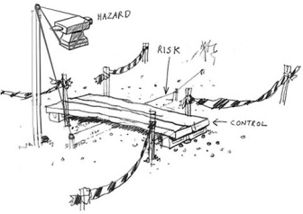
Assessment Tools: Adolescent
 | General Aberrant Behaviour | Violent Behaviour | Sexual Behaviour | Self-Harm & Suicide | Protective Factors | Situational Environment
Male | YLS:CMI | SAVRY PCL:YV | J-SOAP-II PCL:YV | ASAP-20 | SAPROF:YV | PRISM
Female | YLS:CMI | SAVRY PCL:YV |  | ASAP-20 | SAPROF:YV | PRISM
Cognitive Impairment |  | ARIMIDILO-G | ARIMIDILO-S |  |  | PRISM ARIMIDILO
Early Assessment Risk List for Boys (EARL-20B -Version 2)
Early Assessment Risk List for Girls (EARL-21G2)

Slide 29
Assessment Tools: Adult
 | General Aberrant Behaviour | Violent Behaviour | Sexual Behaviour | Self-Harm & Suicide | Protective Factors | Situational Environment
Male | LS-RNR/LSI START | HCR20^{v3} PCL-R/SV | RSVP; SAM SARA; SRP Static-99r | SBRE SRAMM | SAPROF START | PRISM
Female | LS-RNR START | HCR20^{v3} + FAM PCL-R/SV | RSVP STATIC-99r PCL-R/SV | SBRE SRAMM | SAPROF START | PRISM
ID |  | ARMIDILO-G | ARMIDILO-S |  |  | PRISM ARMIDILO
ID Adapted |  | HCR-20 PCL | RSVP PCL SVR-20

Slide 30
Contextualising Harm Mitigating environmental influence!

Slide 31
Situational Risk Management
Management of those salient and negative feature of an environment in which violence takes place.
Based within the three arms of Organisational Security:
Structural Security: the fences, locks, personal alarms, monitors, etc. that help keep people safe.
Procedural Security: the policies and procedures in place to maintain safety and security.
Relational Security: ...

Slide 32
Relational Security
Relational security is the knowledge and understanding staff have of a client and of the environment, and the translation of that information into appropriate responses and care.
It is not simply about having ‘a good relationship’ with a client.
Safe and effective relationships between staff and clients must be professional, therapeutic and purposeful, with understood limits.

Slide 33
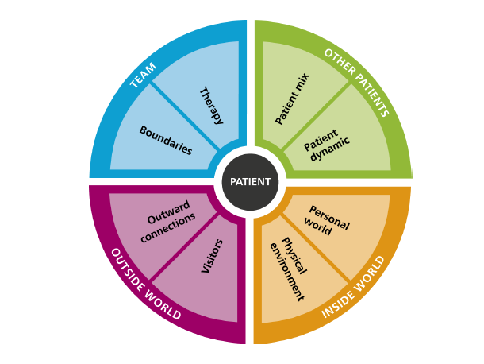
Boundaries
Identifying negotiable and non-negotiable boundaries.
Communicating boundaries to clients and helping them understand the reasons.
Being clear about the information you are going to use to make decisions.
Staying aware of how you feel, how you behave and how other people interpret your behaviour.
Being prepared to challenge clients and staff that violate personal boundaries.
Recognising and confirming the achievement of clients when they get it right.
Being prepared to talk in the team about how you feel and asking for help when you need it.

Slide 34
Therapy
Engaging with clients and making a commitment to treatment.
Involving clients in planning their own care.
Encouraging clients to believe in their own recovery and helping them to see what they can do to improve.
Making sure you know what clients are learning off the unit and supporting them on the unit or helping them practice new skills.
Making certain that clients’ care plans are up to date and relevant to their needs.
Planning how to manage transition and change.
Behaving as a positive role model and setting a good example.

Slide 35
Client/Patient Mix
Being clear about what the limits are for your unit/environment.
Monitoring how clients are interacting with each other.
Measuring the effect that a client arriving or leaving has on the unit/environment.
Staying alert and being prepared to speak up if you have misgivings .
Being prepared and knowing how to act if you need to change the mix.

Slide 36
Client/Patient Dynamics
Detecting suspicious, unusual behaviour between clients.
Being aware of the dynamics on the unit and monitoring change.
Encouraging clients to talk about how the unit dynamics affects them.
Providing clients with a ‘safe space’ to report suspicious behaviour without fear of retribution.
Staying alert and ready to act and move clients if necessary.
Talking about the dynamics with the team, the reasons for any change and the effect it might have on safety and security.

Slide 37
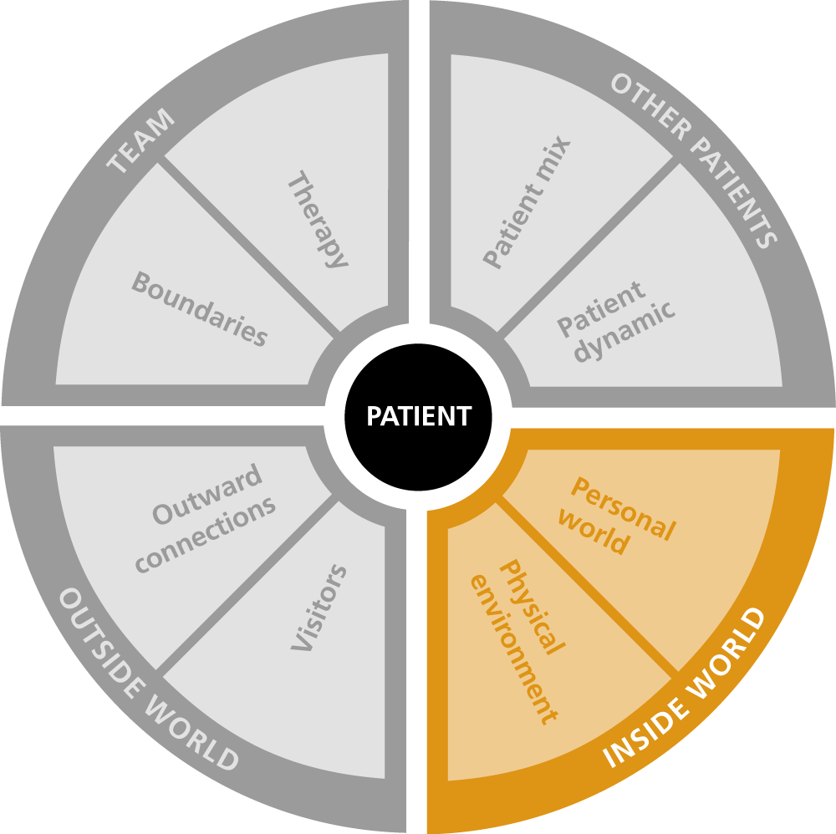
Personal World
Recognising clients as people who have good days and bad days.
Knowing clients’ histories, understand the risks associated with each client and considering possible triggers.
Talking to clients sensitively about what they think their triggers are.
Planning with clients how you will respond to/cope with triggers together.
Staying alert and attentive to change.
Communicating to the team about what you have noticed.
Suicide reports pick up on changes here in retrospect.

Slide 38
Physical Environment
Balance between minimising risk and having a therapeutic environment.
Creating opportunities for positive social engagement.
Arranging the unit so it’s a space where you can observe and engage with clients.
Encouraging clients to care for and take pride in their environment.
Identifying areas that can be used by clients to establish dominance over others.
Minimising noise and overcrowding.
Giving clients the opportunity to access fresh air.

Slide 39
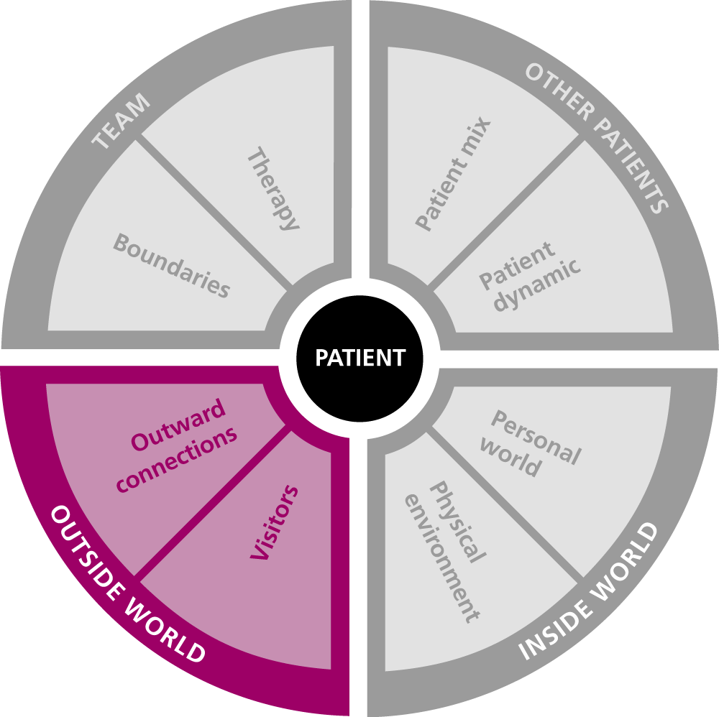
Visitors
Ensuring you know the potential risks to clients and to visitors.
Preparing for and supervising visits.
Talking to visitors about the effect of their visit.
Encouraging visits that you know will play a positive role in a clients recovery.
Detecting suspicious or unusual behaviour during a visit.
Acting on any misgivings you have before, during or after a visit.
Being quick to take action if something unexpected happens.

Slide 40
Outward Connections
Developing clear management plans for when clients have leave.
Being clear with clients about the non-negotiable limits and rules of contact outside the service.
Acting decisively if those limits and rules are breached.
Ensuring clients understand the consequences of absconding.
Alert for signs of unusual behaviour that may indicate a possible abscond.
Acting quickly and safely if something unexpected happens.
Awareness of external responsibilities.

Slide 41
Recording Risk Ensuring risk is documented!

Slide 42
Risk Statement
Risk statements are a clear expression of risk in terms of the nature, seriousness, pattern and likelihood of harm.
Nature: is the type of harm and possible or potential target/s.
Seriousness: combines the degree of harm desired, the degree of harm intended, and the extent of planning in an episode of harm.
Pattern: includes the onset, duration, frequency and escalation of harm.
Likelihood: is understood as the current balance of risk and protective factors/strengths (not expressed as statistical probability).
This statement is then evaluated against the relevant risk criteria for the decision at hand. Risk statements can also be evaluated against legislative and professional practice considerations.

Slide 43
Formulation
Can be defined as:
A theoretically-based explanation or conceptualisation of the information from a specific assessment, used to proffer an ‘understanding’ of a case.
The level of ‘understanding’ is proportionate to the individuals age and stage of development, to the specific circumstances of the case and task at hand.
When assessing the risk of harm it needs to include a hypothesis of how, why and when such aberrant behaviour might occur.
It demonstrates the interaction and role of respective and relevant risk factors, (highlighting precipitating risk factors) that might identify early warning signs and indicate imminence.
This level of understanding is reached through ‘analysis’ and the risk formulation is seen to fundamentally link the assessment of risk with the process of risk management.

Slide 44
Risk Management Planning The management of uncertainty!

Slide 45
Risk Management
The ultimate goal of violence risk assessment is the prevention of harm; that is, minimising the likelihood of, and negative consequences stemming from, any future violence.
A process co-ordinated via the development of risk management plan!
A Risk Management Plan is a shared and dynamic working document, based on a formulation or understanding of risk, in which preventative and contingency action plans show a clear link between identified risks and necessary action, those responsible for those actions, and the required communications. It is responsive to change and should outline review procedures.
Risk management should always be grounded in a broader and detailed assessment of a client’s social, developmental and psychological needs!

Slide 46
Risk Management Plan
A shared and dynamic working document, based on a formulation or understanding of risk, which generally incorporates a number of risk management strategies that fall into four activities:
Intervention: intended to repair or restore adaptive functioning such that risk will be moderated as a consequence.
Supervision strategies: to support the individual such that risk factors do not become ‘active’ and protective factors dominate.
Monitoring guidelines: are those aspects of a client's presentation that signify early warning signs of a relapse into violence.
Victim safety planning: is a selection of strategies used with potential victims to harden them against violence in the future.
Organisation security (structural, procedural, relational) has varying degrees of influence across each activity that requires consideration!

Slide 47
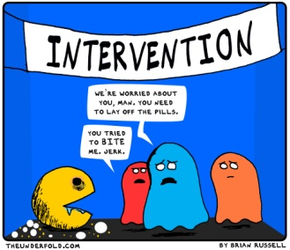
Intervention
Intervention and rehabilitation strategies act to instil, repair or restore adaptive functioning.
Interventions are specific programmes, activities or techniques focused on changing a behaviour or treating a particular problem.
The ‘responsivity’ principle stresses the importance of matching interventions to an individual’s characteristics (learning ability and style, motivation, personality, level of communication skills).
In more complex cases there may be a range of interventions that must be co-ordinated within a plan.
Consideration must be given to Medical/Psychiatric factors (medication, mental state/illness); Psychological (e.g., personality, behaviour management plans, trauma, D&A, cognitive skills, offending behaviour); Psychosocial (e.g., ADL’s, good lives domains).

Slide 48
Supervision
The activity of overseeing or administering an order or condition in a manner consistent with legislation and procedures to ensure compliance.
Intended to support the client such that risk factors do not become ‘active’ and protective factors dominate.
A means by which a relationship is established with the client, to ensure engagement through dialogue in a process of change and compliance.
Either voluntary or statutory, with the principle of ‘proportionality’ being kept in mind (i.e., the least restrictive measures necessary).
Include rules governing potential restrictions on activity, movement, associations, communications, victim access.

Slide 49
Monitoring
Involves observational activities intended to determine progress or deterioration, and is alert to needed changes in the plan.
Is an active component of risk management and is of prime importance when managing the risk of harm.
Supports contingency plans and informs response readiness to change.
Includes monitoring guidelines, which are those aspects that signify early warning signs (‘red flags’) of a relapse into violence.
Helps identify what circumstances, occurrences, or events, should trigger a re-assessment of risk.

Slide 50
Victim Safety Planning
Risk management activities where attention is drawn to the safety of specific individuals or groups who may become victims.
Attempts to devise preventative or contingency strategies.
Consideration of past victimology is of critical importance.
A client may be both a victim and perpetrator of aberrant behaviour.
‘Target hardening’ involves increasing victim resilience toward future impacts of harm or violence.
May include self-protective behaviours, personal boundaries, safe space, formal communication, training, education, clinical supervision, and relational security.

Slide 51
Communicating Risk Ensuring risk is heard!

Slide 52
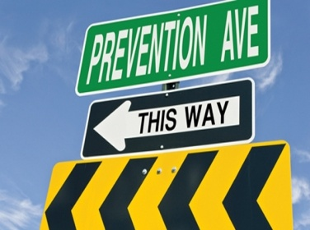
Reporting
Biopsychosocial Background
Structured Assessment of Risk
Summary Risk Judgments
Opinion & Formulation
Statement of Risk
Risk Management Plan/Recommendations
Treatment
Supervision
Monitoring
Victim Safety Planning

Slide 53
Points of Clarification? Outstanding Issues! Discussion.
Notes:
Templates:
Risk management plan (RMP) – in particular templates that are holistic (all areas of life) and can integrate multiple perspectives eg service/discipline
Behaviour management/Support plan (BM/SP)
Risk assessment/tools- which ones???
Understanding the difference between RMP and BM/SP. Including practical guidance eg when to use, for what purpose, recommended content, holistic V’s specific
Discuss different examples of RMP and BM/SP including extensive holistic documents V’s brief plans and how these are utilised for different purposes
How to assist care team to develop RMP and BM/SP
Developing a RMP that encompasses the MACNI platforms within the Assessment/Service Plans eg What are the risk factors for someone losing their housing, who would be responsible for managing this, timeframes and what would be the likely outcome
Framework for risk assessment in those circumstances where no formal assessment exists, that prompts the discussion of from what discipline, and from what evidence base
Developing a common conversation/understanding around ‘professional defensible risk’.
Developing confidence/expertise in integrating risk assessments and directing discussion accordingly
Particularly positive risk- that is encouraging a common commitment to acceptable parameters for risk. ( I think this relates to our discussion this morning to new emerging DHHS lingo re Low/Med/High risk v Acceptable/Tolerable risk)
Risk Management within a certain framework eg Disability- within the broader conversation of ‘risk’ how do we shift the conversation from ‘behaviour management’ to positive behaviour support.

Slide 54
Contact Details
Email Address:
Dr.Gee@AustralasianPsychologyServices.co
Presentation available from:
www.AustralasianPsychologyServices.co/newsevents

